Slide 1
KOKO SMS Editor
Q1 2020

Slide 2
Current SMS Setup at Koko
Vision & Roadmap of the SMS Editor
Existing SMS Information
Version 1
Designs of V1
Requirements & User Stories
Questions & Assumptions
Release Plan
Next Steps
Updated Scope
Version 2/3

Slide 3

SMS at Koko - Current Setup
The business needs to be able to engage with customers as often as possible (ie. whenever they need/want to) in an efficient, simple and convenient manner.
Today, multiple SMSes are sent from different platforms across multiple customer journeys.
Many of these SMSes require updates on an ongoing basis. At the moment, changing SMS content currently requires a code change and a KOKO Core release which limits our ability to easily control our customer communications.
The current documentation was being amended on a manual basis and is now out of date.
Basically, with the current system, the business finds it difficult to manage the process of engaging with customers via the SMSs.

Slide 4
Current Landscape of KOKO SMSes
Type of SMS | Description | Platforms Involved | Points to Note
Unique SMS | SMSes sent to individual recipients. | KOKO Core | SMSes are initiated/sent out manually
Bulk SMSes | SMSes sent to multiple recipients, at once.. | Telerivet | SMSes are sent out manually At the moment, we use ‘Telerivet’, a third-party tool, to send out bulk smses
Customer Journey SMSes | Trigger-Based Automated SMSes sent/triggered by defined customer activity. | (Pre-defined) Server-side Triggers on KOKO Core, MyKOKO, KP | SMSes are automated. List of live SMSes as per pre-defined triggers can be found here.
Customer Care/ Issue-based SMS | SMSes sent from Zendesk when resolving a customer issue | Zendesk | Zendesk calls an API to send SMS to customers. The event is logged against the customer in KOKO Core.
Wallets-based SMS | SMSes sent from customer top-up activity | KOKO Core & Kopo Kopo | Kopo Kopo sends SMS confirming transaction of top-up sent to KOKO

Slide 5
Vision & Roadmap

Slide 6
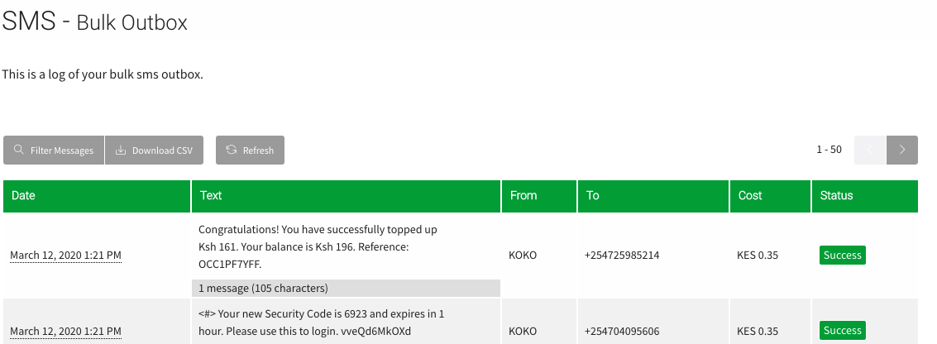
KOKO SMS Editor - Vision & Purpose
We need to be able to engage with any KOKO customer in an official SMS-manner, whenever we need/may wish to.
The Koko SMS Editor would make it possible to send SMSes to Koko Customers in a quick, easy, transparent and efficient manner.
What is the vision of the SMS Editor?
Insight/Accountability: We need to know what SMSes our customers are receiving, how often and when.
Analysis: We need to be able to tell if SMSes are sent out successfully, how they perform and where room for improvement lies.
(SMS-Based) Engagement: We need to be able to build trust with our customers (within our various customer journeys) by sending important and relevant information to them via sms.

Slide 7
SMS Editor - Types of SMSes
The SMS Editor will be used to manage (create, edit, delete, send and analyse) the following types of SMSes:
Ad-hoc SMSes: Single/ bulk smses sent at will by the user of the SMS editor.
Trigger-Based Automated SMSes: Pre-defined SMSes tied to customer activity and pre-defined triggers.
Important points to note:
Version 1 of the SMS editor will not include functionality to send SMSes based on new triggers.

Slide 8
SMS Editor - RoadMap Features
Version 1
Version 2/3
Version 1/2 Iterations:
Vision of the KOKO SMS Editor
Current Goal:
Improve the existing process of editing SMSes
Iterations:
Improvements to features of V1 and/or V2
Near Term Goal:
Improve the quality of SMSes sent
A tool that makes it possible to manage all KOKO SMSes in a simple, efficient & powerful way
View Existing SMSes
Create New Triggered SMSes
Creates New Adhoc SMSes
Schedule SMSes
?
Edit & Update Existing SMSes
Sends New Adhoc SMSes Instantly
Customer Language Preferences
Track Sent SMSes
?
Scoping
Pending Priority
Pending Observations
Notes:
NB: Subject to change based on priority

Slide 9
SMS Editor - RoadMap Features
Version X
Vision of the KOKO SMS Editor
Long Term Goal:
Analyse & measure the impact of SMSes
A tool that makes it possible to manage all KOKO SMSes in a simple, efficient & powerful way
Run A/B Test SMS Campaigns
View Reports on SMSes & Campaigns
Pending Priority
Notes:
NB: Subject to change based on priority

Slide 10
SMS Editor Features - V1 Scope
Priority | Feature | Description
Top | View Existing SMSes | View the content/copy, platform, triggers (if any), description of all current Koko SMSes.
Top | Edit Existing SMSes | Edit copy/content of existing SMSes Edit description of an SMS Update (save) the changes made De-activate existing SMSes
Medium (already happening on Koko Core & Telerivet) | Create New SMSes | Create copy/content of SMS Select dynamic fields eg. Name, Balance, etc Save draft of SMS
Medium (already happening on Koko Core & Telerivet) | Send New SMSes | Select recipient(s) of SMS Send SMS immediately Confirm that SMS has been sent successfully
Medium (depends on who initial users of SMS Editor will be) | Access Limitations | Only some users can send bulk smses Only some users can edit/create smses Only some users can delete smses

Slide 11
KOKO Existing (Trigger-Based) SMSes
Information on existing SMSes

Slide 12
Existing SMSes: Overall Flow
Users...
...take action (activity)...
...which triggers...
...a specific SMS (to be sent)!
...“fulfill_kit:bonus_fuel” is triggered
...“stove_order_cancellation” is triggered
...“successful_agent_topup” is triggered
...“BONUS: You have been awarded %(currency)s %(amount)s of free fuel…”
...“Dear {name}, your stove order has been cancelled. {currency} {refund_amount} has been refunded…”
...“Thank you for your payment of {currency} {topup_amount}...”
Customer collects a cooker (fulfills)...
Admin cancels a customer’s order...
Agent tops-up...
Types of Users:
Customers
Admins
Agents
Example

Slide 13
SMS Editor - Existing SMSes
Existing SMSes are automated and tied to existing pre-defined triggers. These triggers are defined by the activity of specific KOKO users.
These existing SMSes are categorised according to the activity of these KOKO users (customer, admin, agent).
Customer Activity
Admin Activity
Agent Activity
For ease of understanding, the existing SMSes can be grouped within the following journeys:
Sign-Up Related
Managing an Order
Managing an Account

Slide 14
Existing SMSes: Customer Activity SMS Types
User
CUSTOMER
Sign-Up Related Activity
Manage Order Activity
Manage Account Activity
Group
Signs Up & creates a KOKO Pin
First Sign Up
Signs Up a New Customer
Receives Top Up Info
Click here for SMS Details
Buys Cooker
Collects Cooker (fulfills)
Collects Cooker/Canister
Registers to save for cooker
Places Cooker Order (has some money in account)
Signs up within the last 14 days
Makes pre-order within 24-48hrs
Click here for SMS Details
Tops Up Account
Requests PIN Reset
Creates New PIN
Has inactive account
Receives credit from another Koko customer
Sends credit to another KOKO customer
Accidentally locks account
Click here for SMS Details
Activities
Notes:
Full list of existing smses as categorised is here

Slide 15
Existing SMSes: Customer Activity Triggers
Signs Up & creates a KOKO Pin
First Sign Up
Signs Up a New Customer
Receives Top Up Info
Click here for SMS Details
Buys Cooker
Collects Cooker (fulfills)
Collects Cooker/Canister
Registers to save for cooker
Places Cooker Order (has some money in account)
Signs up within the last 14 days
Makes pre-order within 24-48hrs
Click here for SMS Details
Tops Up Account
Requests PIN Reset
Creates New PIN
Has inactive account
Receives credit from another Koko customer
Sends credit to another KOKO customer
Accidentally locks account
Click here for SMS Details
Customer Activities
purchase_kit:order_success
fulfill_kit:bonus_fuel
fulfill_kit:success
order_creation:kp_buy_now_neighbourhood_not_available
order_creation:kp_save_non_zero_balance_or_has_stove
pre_order:topup_reminder_kp_not_available
pre_order:conversion_to_saving_program
Click here for SMS Details
topup:success
forgot_pin:temporary_pin
pin:change
account_locked_msg
transfer:recipient_sms
transfer:sender_sms
pin:account_locked
Click here for SMS Details
signup:success_topup_info
signup:success_temporary_pin
PROMOTER_TOPUP_MESSAGE
signup:success_topup_info
Click here for SMS Details
Trigger Names
Notes:
Full list of existing smses as categorised is here

Slide 16
Existing SMSes: Admin Activity SMS Types
ADMIN
User
Sign-Up Related Activity
Manage Order Activity
Manage Account Activity
Group
Signs up New customers from Admin Portal
Click here for SMS Details
Cancels Order from Admin Portal
Cancels Pre-order from Admin Portal
Click here for SMS Details
Tops Up Customer accounts (in Bulk) from Admin Portal
Credits Customer's account from Admin Portal
Charges customer's account from Admin Portal
Resets customer's PIN from Admin Portal
Click here for SMS Details
Activities
Notes:
Full list of existing smses as categorised is here

Slide 17
Existing SMSes: Admin Activity Triggers
Signs up New customers from Admin Portal
Click here for SMS Details
Tops Up Customer accounts (in Bulk) from Admin Portal
Credits Customer's account from Admin Portal
Charges customer's account from Admin Portal
Resets customer's PIN from Admin Portal
Click here for SMS Details
Cancels Order from Admin Portal
Cancels Pre-order from Admin Portal
Click here for SMS Details
Admin Activities
B2B_WALLET_TOPUP_MESSAGE
transact:credit_sms
transact:charge_sms
pin:admin_reset
Click here for SMS Details
STOVE_ORDER_CANCELLATION
STOVE_PRE_ORDER_CANCELLATION
Click here for SMS Details
BULK_SIGNUP_MESSAGE
Click here for SMS Details
Trigger Names
Notes:
Full list of existing smses as categorised is here

Slide 18
Existing SMSes: Agent Activity SMS Types
AGENT
User
Sign-Up Related Activity
Manage Order Activity
Manage Account Activity
Group
N/A
Click here for SMS Details
Agent Tops-Up
Click here for SMS Details
N/A
Click here for SMS Details
Activities
Notes:
Full list of existing smses as categorised is here

Slide 19
Existing SMSes: Agent Activity Triggers
Agent Tops-Up
Click here for SMS Details
Agent Activities
SUCCESSFUL_AGENT_TOPUP
Click here for SMS Details
Trigger Names
Notes:
Full list of existing smses as categorised is here

Slide 20
Version 1
User Flows, Designs, Scope Requirements

Slide 21
SMS Editor - V1 Existing SMSes
Version 1 will include the ability view, edit & update existing SMSes.
Important point to note:
Version 1 of the SMS editor will not include functionality to create new triggers or new SMSes.
Each SMS will have the following information attached to it:
SMS Content/Copy
SMS Dynamic variables
Description
Trigger Name (Process Type ie how it is identified within the system)
Trigger Details (When the SMS is sent)
Platform(s) Involved
Language(s)

Slide 22
SMS Editor - Existing SMS Details
Find the comprehensive list of existing KOKO SMSes here
(colour-coordinated)
SMS Description
Language
Copy/Content
User Activity
Each KOKO SMS
Dynamic Variables
Trigger Details
(when SMS is sent)
Involved Platform
Trigger Name
(process type)

Slide 23
Version 1: User Flow A (View, Search & Filter SMSes)
Flow A: User wants to audit, edit and update the state of an existing SMS
User Logs In
Views SMS trigger information (when is SMS sent)
Selects an SMS to edit
Edits content of SMS (text and dynamic variables)
Saves Updates Made
Views All SMSes
Searches for an SMS
Searches based on keywords in the SMS
Edits description of SMS (why this SMS exists)
Views log with the recent changes on the SMS activity log
Filters list of SMSes
Filters SMSes based on language and platform
De-activates SMS (makes SMS inactive)

Slide 24
Version 1: User Flow B (Triggers & Dynamic Variables)
Flow B: User wants to audit and understand existing SMS Triggers and Dynamic Variables
User Logs In
‘Trigger Information’
Views the names and meaning of each trigger
‘Dynamic Variables Information’
Views the names and meaning of each dynamic variable

Slide 25
Summary of Scope for Editor V1
Scope areas | Details
View all existing KOKO SMSes | Copy of each SMS Trigger of each SMS (when SMS is sent) Description of each SMS Language of the SMS Platforms involved
Edit an existing KOKO SMSes | Edit the copy Edit the description of the SMS
Update an existing KOKO SMSes | Save edits made to the SMS information
De-activate existing KOKO SMSes | Stop an SMS from running ie deactivate it
Log updates on existing SMSes | View an activity log of the updates made to each SMS: User name who made an update Date of update

Slide 26
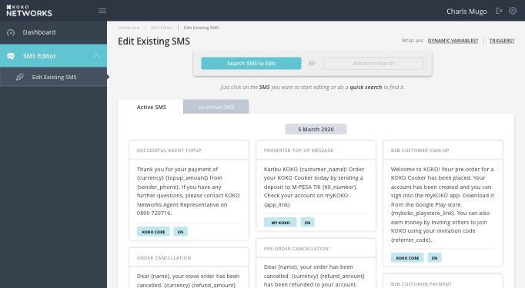
Designs (View Existing SMSes)
When user logs in, they can view:
The current active SMSes
The current In-Active SMSes
Search Bar
Cards of SMSes with their trigger names and content
Tip Section for variables and triggers
Notes:
Link to Interactive Designs: Designs

Slide 27
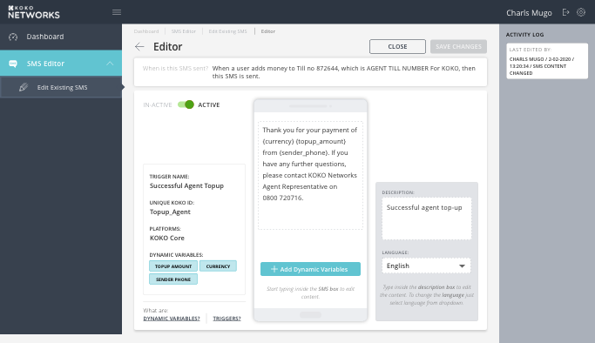
Designs (Edit & Update Existing SMSes)
Edit an SMS:
Edit Copy
Add/Remove dynamic variables to the copy of SMS
Edit Description of SMS
Make it “Inactive”
View activity log of edits made
View info such as the trigger name and details associated with the SMS, and platforms involved
Notes:
Link to Interactive Designs: Designs

Slide 28
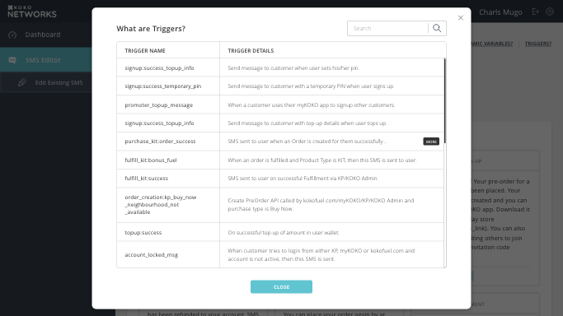
Designs (Info on Existing SMS Triggers)
Information on the triggers within the system and what they mean.
User can use also use the search bar to find specifics.
Notes:
Link to Interactive Designs: Designs

Slide 29
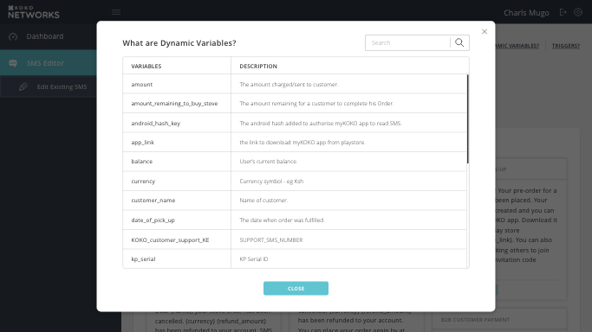
Designs (Info on Existing SMS Dynamic Variables)
Information on the dynamic variables within the system and what they mean.
User can use also use the search bar to find specifics.
Notes:
Link to Interactive Designs: Designs

Slide 30
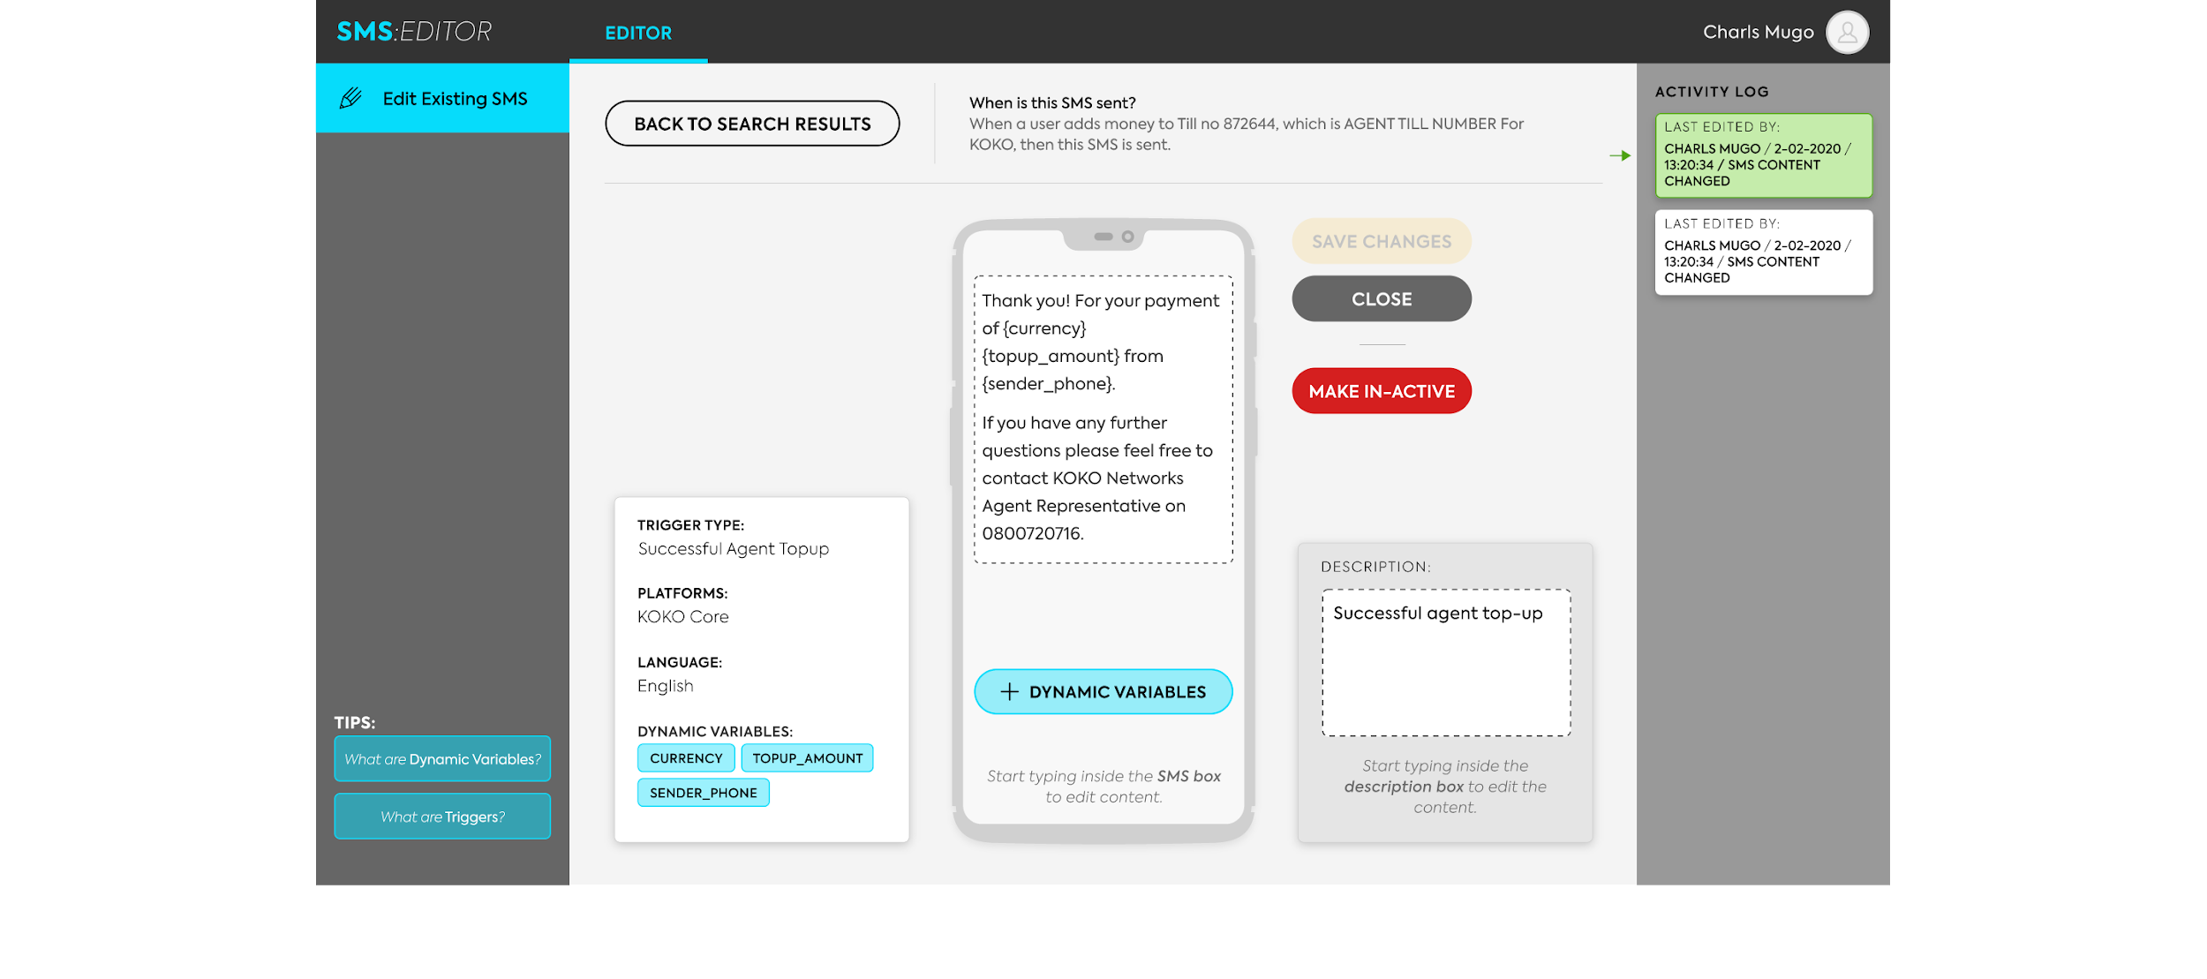
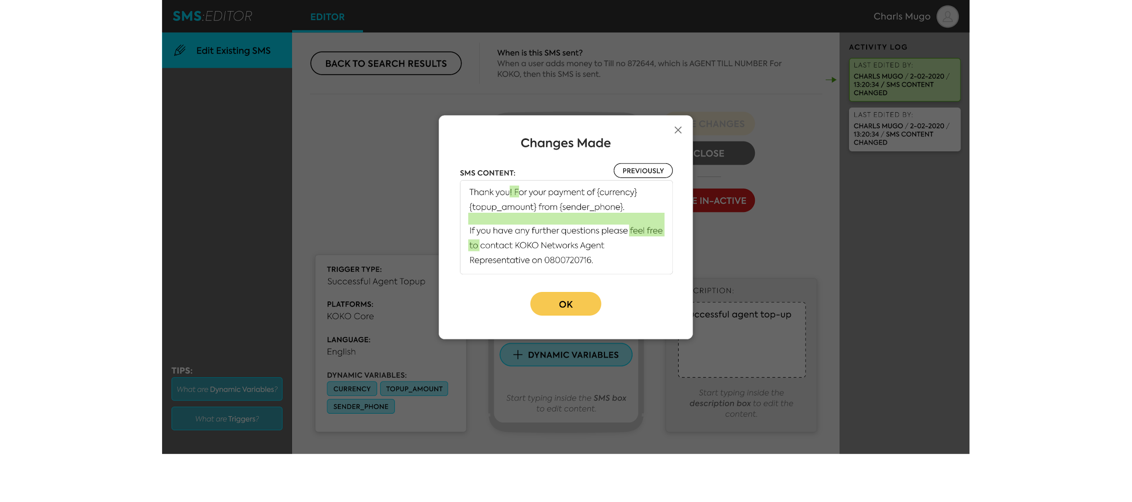
Designs (Activity Log)
Realtime activity log of any updates made to an SMS:
Name of editor
Date of edits
Type of edit (SMS Content, SMS Description)
Users can also see the details of the content changed/edited.
Notes:
Link to Interactive Designs: Designs

Slide 31
Requirements
Key Requirements - More information on the requirements can be found on the PRD here
Key Requirements | Details
Each trigger name must be unique in the system | Trigger names should not match
Authentication/ log in permissions to the editor should match that of KOKO Core | ‘View SMS Editor’ permissions on KOKO Core can view the SMS editor ‘Edit SMS Editor’ permissions on KOKO Core can edit, update and deactivate SMSes
Updates (saved edits & de-activates) made to each SMS must be visibly logged for users to keep track | Should include the details on who (name of user that logged in) updated an sms, what was updated (SMS content/description) and when (date of update)
Users cannot edit trigger names/details | Trigger names cannot be edited by users Trigger details (when an SMS is sent) cannot be edited by users
Users cannot edit dynamic variables names/details | Dynamic Variable names cannot be edited by users

Slide 32
Constraints
Constraints to be aware of:
Dynamic variables are not available to every SMS equally. Specific dynamic variables are limited to specific SMSes.

Slide 33
Release Plan
Release Plan: x Stages
Scope | Tentative Release Date | Notes

Slide 34
Questions & Assumptions
Can/should users be able to edit the names of triggers??
Do we need access limitations since the users of V1 will probably be leadership of customer, business and sales teams?
What kind of authentication/permissions/access should we set up? Matching that of Koko Core? Are we creating permissions separate from KOKO Core?

Slide 35
Next steps
Clarify open questions and potential user journeys - done
Discuss priority of different scope elements - done
Prepare final designs - done
Confirm sign off - done
Plan resourcing with Engineering Team - done
Walkthrough engineering team - done
Finalize the Release Plan with engineering - pending

Slide 36
Scope Updates
30th Jan
The ability to create new SMSes based on triggers is out-of-scope for now; the system isn’t set up for that.
8th May
Make language field editable
Combine the fields ‘trigger details’ and ‘SMS description’
11th May
Link permissions/roles to KOKO Core
Include link to SMS Editor from KOKO Core - update designs

Slide 37
For more information, contact:
Nyawira Njoroge
n.njoroge@kokonetworks.com

Slide 38
Archives

Slide 39
SMS Editor - Potential V2/V3
Target | Feature | Description
Increase effectiveness of SMSes for the recipient | Language Preferences | Pull language preference for customer from koko core (eg. does customer prefer English/Swahili, etc)
Create segments/groups for SMS recipients | Trigger-Based SMSes | Sending new SMSes based on customer activity eg. 3rd dispense of fuel, etc
 | Schedule SMSes | Select time and day for sms to be sent Confirm that sms was sent on schedule
 | Tracking SMSes | View confirmation of SMSes sent successfully View alert of SMS not sent View confirmation of SMS received (TBC) View alert of SMS not received
 | Reports (TBC) | Number of SMSes received Number of SMSes not received Recipients not receiving SMSes Recipients who received SMSes

Slide 40
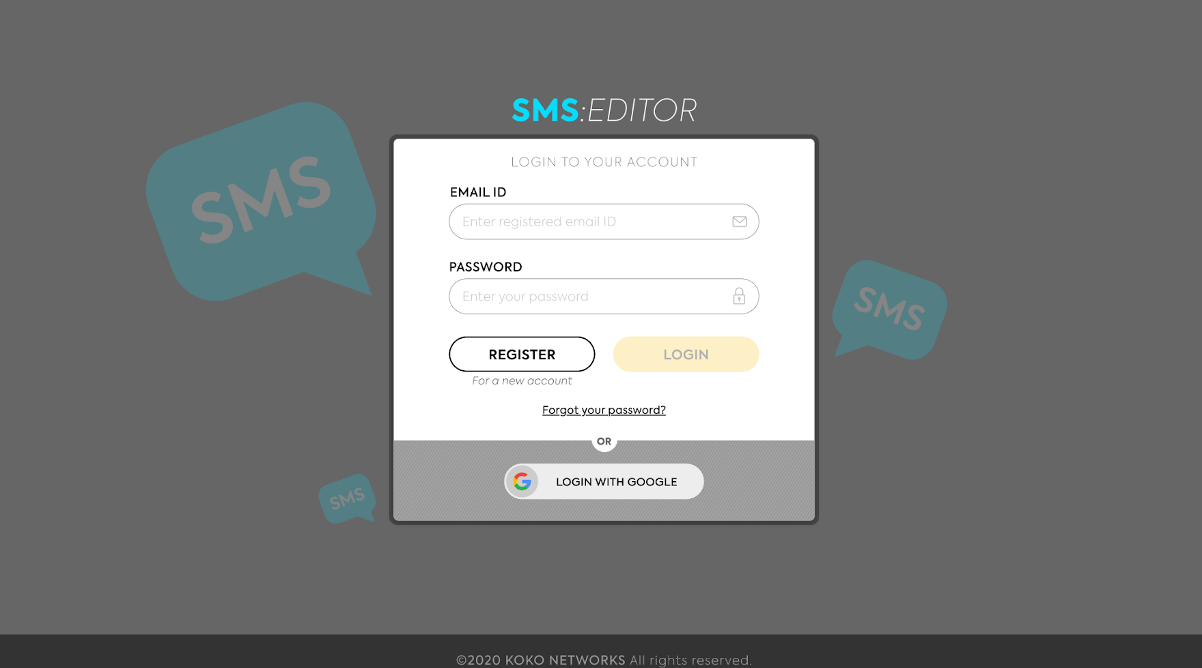
Designs (Log In/Sign Up)
User can access the SMS Editor via the log in/sign up page
Interactive Design Link:
https://xd.adobe.com/view/fe071760-b6a0-42ba-651e-e20ad4cdb9f5-8836/?fullscreen

